Slide 1
Machine learning in ios

Slide 2
Table of Contents
Brief introduction to machine learning
Introduction To Machine learning In IOS
What is CoreML?
A little context for CoreMl
Enter CoreML
What else does CoreML provide?
Pros and Cons of using CoreML

Slide 3
Brief introduction to Machine learning
Machine learning :
To teach a computer to learn without being explicitly programmed
Model :
Go through data iteratively to predict new, unknown data.

Slide 4
Brief introduction to Machine learning
Machine learning Philosophy :
The machine learning philosophy is, at a high level, that of letting large amounts of data dictate algorithms and solutions for complex inferential problems

Slide 5
Brief introduction to Machine learning
Supervised Learning
Unsupervised Learning
Reinforcement Learning

Slide 6
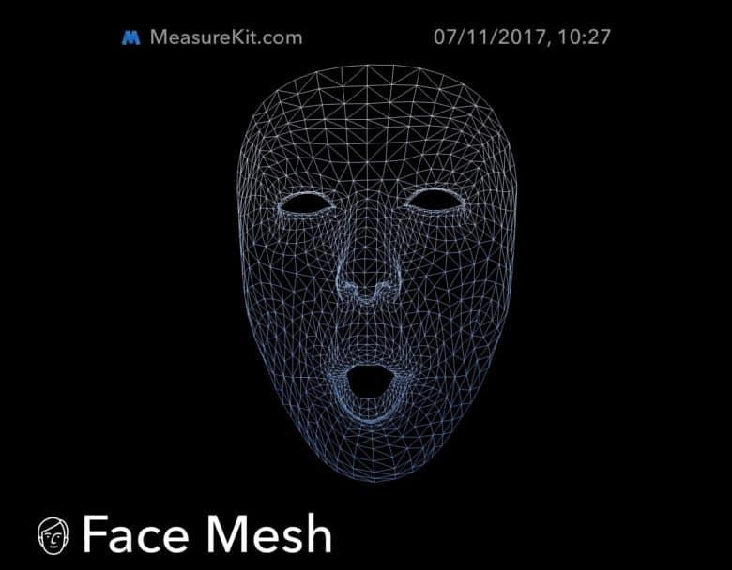
Introduction
Apple iPhone X FaceID, Animoji, Augmented Reality use the power of machine learning.
The hacker in me wanted to get my hands dirty and figure out what it takes to build a system like that?

Slide 7
Introduction
When probed further, the answer was CoreML which is Apple’s official machine learning kit for developers.
With a powerful computing engine at its core, the iPhone will now be open to new avenues of machine learning and the significance of CoreML will only rise in the coming days.

Slide 8

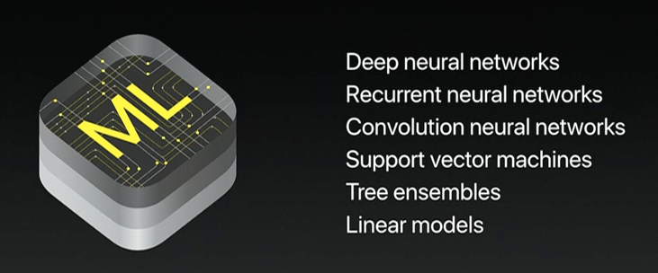
What is CoreML?
Apple launched CoreML this year in their annual developer conference WWDC(which is equivalent to Google I/O conference) with a lot of hype. In order to better understand CoreML’s role, we have to know a bit of context.

Slide 9
A little context for CoreML
Interestingly this is not the first time that Apple has come out with a framework for machine learning on its devices. Last year it launched a bunch of libraries for the same:
Accelerate and Basic Neural Network Subroutines (BNNS) – Efficiently utilize CPU for predictions using Convolutional Neural Networks.
Metal Performance Shaders CNN (MPSCNN) – Efficiently utilize GPU (parallel processing )for predictions using Convolutional Neural Networks.

Slide 10
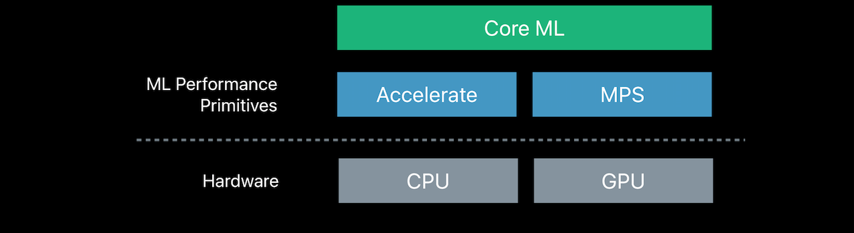
Enter CoreML
CoreML provides another layer of abstraction over the previous two libraries and gives an easy interface to achieve the same level of efficiency. Another benefit is that CoreML takes care of context switching between the CPU and GPU itself while your app is running.

Slide 11
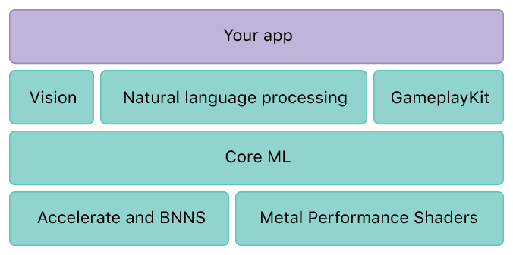
What else does CoreML provide?

Slide 12
What else does CoreML provide?
CoreML also comes with three libraries built on top of it :
Vision: A library that provides high-performance image analysis and computer vision techniques to identify faces, detect features, and classify scenes in images and video.
Foundation (NLP): As the name suggests it is a library that provides functionality natural language processing.
Gameplay Kit: A library for game development also provides AI for the same, uses decision trees.

Slide 13
Pros of CoreML
Optimized for on-device performance, which minimizes memory footprint and power consumption.
On-device means privacy of user data, you no longer need to send data to your servers to make predictions.
It supports many models as it can import models from other popular machine learning frameworks :
support vector machines (SVM)
tree ensembles such as random forests and boosted trees
linear regression and logistic regression
neural networks: feed-forward, convolutional, recurrent

Slide 14
Cons of CoreML
Native support for Supervised models only doesn’t have support for unsupervised or reinforcement learning.
No training on the device, only inference(prediction).
If CoreML does not support a certain layer type, you can’t use it. Currently impossible to extend Core ML with your own layer types.
Core ML conversion tools only support specific versions of a limited number of training tools (no tensorflow, what??)
You cannot look at the output produced by intermediate layers, you only get the prediction.
Only supports regression & classification (clustering, ranking, dimensionality reduction, etc. are not supported)

